Slide 1
CT026-3-2
Human Computer Interaction
Human Computer Interaction
Design & Prototype
Level 2
Prepared by: RZW First Prepared on: December, 2007 Last Modified on: Feb 2018
Quality checked by: MOH
Copyright 2004 Asia Pacific Institute of Information Technology

Slide 2
Topic & Structure of the lesson
What is participatory design
What is card sorting
What is prototype
Why prototype
Types of prototyping

Slide 3
Learning Outcomes
At the end of this lecture, you should be able to:
  Explain participatory design and its importance to usability engineering
  Apply methods such as card sorting in designing any system or application
  Define the term “prototyping”
  Explain the importance of prototyping in designing for usability
  Identify the types of prototypes

Slide 4
Key Terms you must be able to use
If you have mastered this topic, you should be able to use the following terms correctly in your assignments and exams:
Participatory design
Card sorting
Prototype
Low-fidelity prototype
High-fidelity prototype
Storyboards

Slide 5
What is participatory design
Participatory design is an approach to design that attempts to actively involve the end users in the design process to help ensure that the product designed meets their needs and is usable.

Slide 6
Design
At this stage, you should already have established:
Who are your users
Their requirements
The usability goals, human factors and design principles to be considered in the design
Parallel designs from each team member

Slide 7
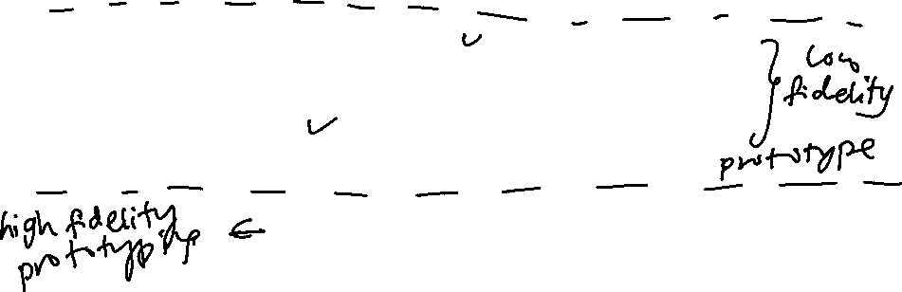
What is participatory design
Users, Tasks, Environment Analysis
Usability Goals , Competitive Analysis
Parallel Design Sketches
Participatory Design
First Prototype
Understanding users
Understanding tasks
Interface issues
Iterative Design
Formative Testing
Final Released Product

Slide 8
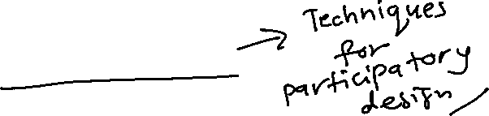
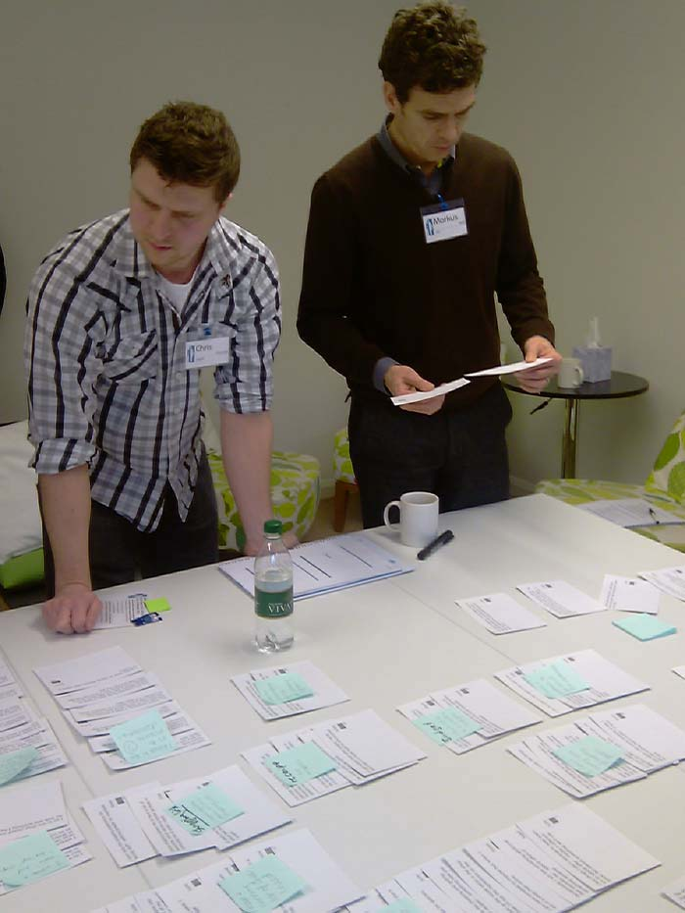
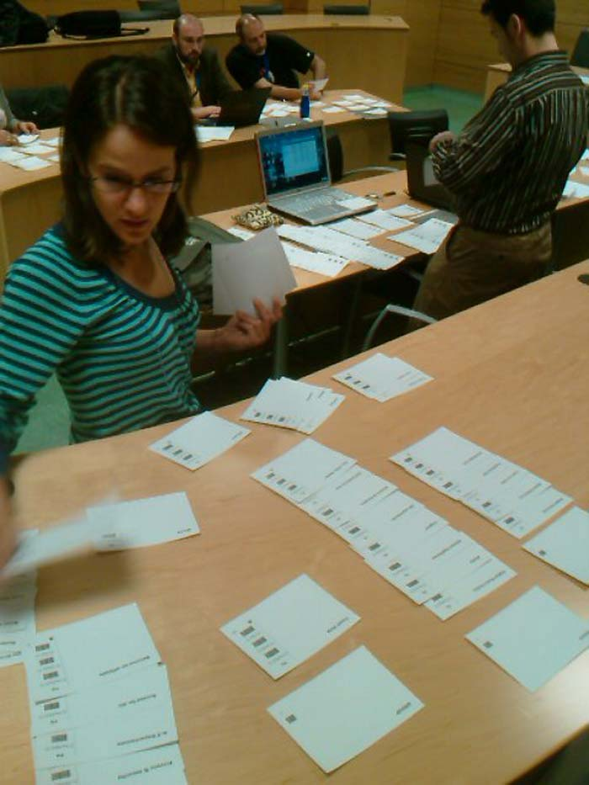
Card Sorting
Card sorting is a quick, inexpensive, and reliable method, which serves as input into your information design process
Card sorting generates an overall structure for your information, as well as suggestions for navigation, menus, and possible taxonomies.
The process involves sorting a series of cards, each labeled with a piece of content or functionality, into groups that make sense to users or participants.

Slide 9
Card Sorting Cont..
ADVANTAGES
Simple – Card sorts are easy for the organizer and the participants.
Cheap – Typically the cost is a stack of 3×5 index cards, sticky notes, a pen or printing labels, and your time.
Quick to execute – You can perform several sorts in a short period of time, which provides you with a significant amount of data.
Established – The technique has been used for over 10 years, by many designers.
Involves users – Because the information structure suggested by a card sort is based on real user input, not the gut feeling or strong opinions of a designer, information architect, or key stakeholder, it should be easier to use.
Provides a good foundation – It’s not a silver bullet, but it does provide a good foundation for the structure of a site or product.
DISADVANTAGES
Does not consider users’ tasks – Card sorting is an inherently content-centric technique. If used without considering users’ tasks, it may lead to an information structure that is not usable when users are attempting real tasks. An information needs analysis or task analysis is necessary to ensure that the content being sorted meets user needs and that the resulting information structure allows users to achieve tasks.
Results may vary –The card sort may provide fairly consistent results between participants, or may vary widely.
Analysis can be time consuming – The sorting is quick, but the analysis of the data can be difficult and time consuming, particularly if there is little consistency between participants.
May capture “surface” characteristics only – Participants may not consider what the content is about or how they would use it to complete a task and may just sort it by surface characteristics such as document types.

Slide 10
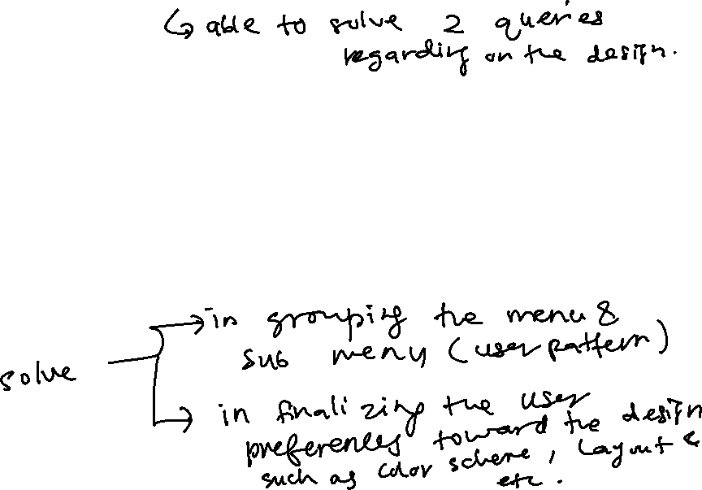
Card Sorting Types
There are two types of Card-Sorting
  To assist in determining the best way of organising user options. e.g. Menus
  To assist in determining the best out of several possible interface design aspects.
  e.g. Colour choices, Navigation arrangements

Slide 11
Card Sorting Types - 1
Card sorting is a technique for exploring how people group items, so that you can develop structures that maximize the probability of users being able to find items
Is easy and cheap to conduct
Enables you to understand how “real people” are likely to group items
Identifies terminology that is likely to be misunderstood.

Slide 12
Card Sorting Types- 1
E.g. How would you group these tasks into 3 groups?
(File, Edit, View)
open, cut, normal view, close, copy, zoom in, save, paste,
zoom out, save, select, toolbar, print
Online tools are available in conducting the activities mentioned above, such as Optimal sort. It is an online card sorting software used as on of the UX design tools.
You can visit this link to try it out: https://www.optimalworkshop.com/

Slide 13
Card Sorting Types - 2
Card sorting is also a technique for allowing users actual selections out of several options to determine final design decisions
Is easy and cheap to conduct
Enables you to determine ‘actual’ preferences versus what users ‘think’ they prefer
Allows for more accurate understanding by user since actual examples are seen

Slide 14
Card sorting Types 2
Title
Title
Title
Title
Content
Content
Content
Content
A
B
C
D
Title
Title
Title
Title
Content
Content
Content
Content
E
F
G
H

Slide 15
Design Process
Two types of design:
  conceptual – developing conceptual model, captures what the product will do and how it will behave
  “A description of the proposed system in terms of a set of integrated ideas and concept about what it should do, behave and look like, that will be understandable by the user in the intended manner.”
  physical – details of the design, e.g. screen design, which icons to be used, graphics, how to structure the menus and etc.
To effectively evaluate the design of an interactive product, we must produce interactive versions of the design

Slide 16
Prototype
A limited representation of a design that allows users to interact with it and to explore its suitability
Allows stakeholders to interact with the envisioned product, gain some experience of using and explore imagined uses
  E.g. paper-based storyboards of a system, cardboard mockup for a desktop laser printer, hyperlinked screens
  E.g. PalmPilot’s founder Jeff Hawkin, carry a carved wood about the shape and size of the device to simulate scenarios of use.

Slide 17
Why prototype
Communication device among design team members
Test out technical feasibility of an idea
Effective way for user testing/evaluation
Clarifying vague requirements
Recommended in software design, to come before any writing of code

Slide 18
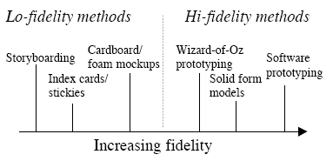
Types of prototyping
The determining factor in prototype fidelity is the degree to which the prototype accurately represents the appearance and interaction of the product, not the degree to which the code and other attributes invisible to the user are accurate.

Slide 19
Low-fidelity prototyping
Low-fidelity prototypes provide limited or no functionality.
They are intended to demonstrate the general look and the feel of the interface, but not the detail how the application operates.
They are created to communicate and exchange ideas with the users
They are cheap and quick to produce -therefore, they support the exploration of alternative designs (multiple iterations)
They are particularly good for:
  Considering early design issues, e.g. layout of controls and display items, sequencing, etc.
  Identifying fundamental problems, I.e. those which lead to errors, confusions, major dislikes

Slide 20
Low-fidelity prototyping
Examples
Storyboarding
  Series of sketches showing how a user might progress through a task using the device being developed
  Often based on scenarios - typical activities
  involving the product/system in a story form

Slide 21
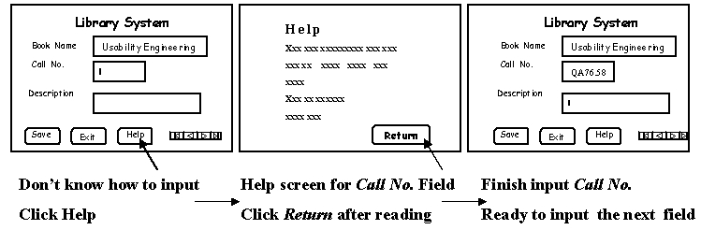
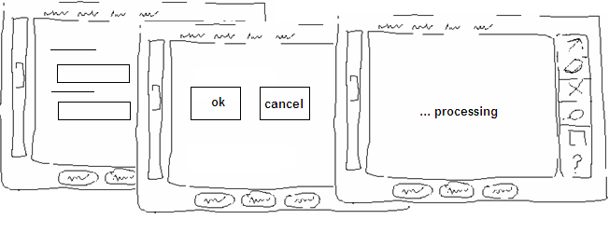
Low-fidelity prototyping
- storyboarding

Slide 22
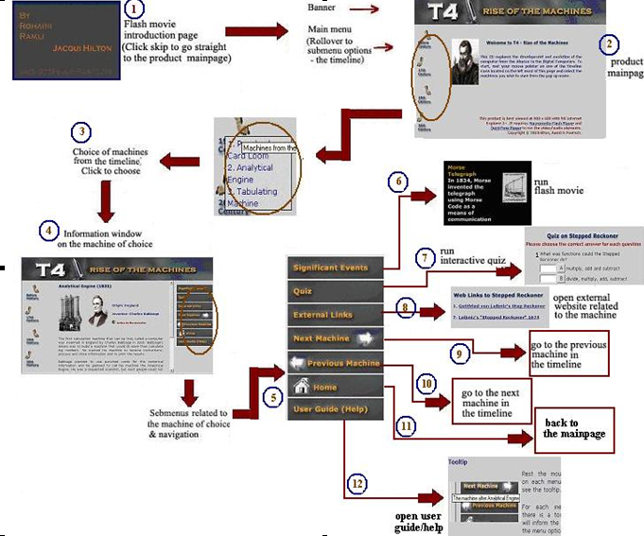
Low-fidelity prototyping - storyboarding

Slide 23
Low-fidelity prototyping
Index Card/Stickies
  Each card/sticky represents an element of a task, one screen or a screen element
  Used in user evaluations where a member of the design team “plays the computer”
  Difficulties encountered are observed and/or recorded

Slide 24
Low-fidelity prototyping
Advantages
  Lower cost
  Evaluate multiple design concepts
  Useful communication device
Disadvantages
  Limited error/usability checking
  Facilitator driven
  Navigational and flow limitations

Slide 25
High-fidelity prototyping
High-fidelity prototypes are fully interactive, simulating much of the functionality in the final product.
Users can operate on the prototype, or even perform some real tasks with it, they faithfully represent the interface to be implemented in the product.
Time consuming and expensive to develop, however:
  Enable a wider range of usability issues/ problems to be considered/uncovered
  Enable other quality attributes such as aesthetics to be
  evaluated
  Impress management, serve as a good marketing and sales tool

Slide 26
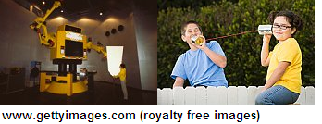
High-fidelity prototyping
3D form with some limited interaction possible
A range of materials may be employed
Very useful when the physical fit/feel of the product is critical, e.g. a handheld device, a wearable device

Slide 27
High-fidelity prototyping
E.g.
Software prototyping
Computer-based mock-ups of interface enabling sophisticated user-system interactions
Variety of prototyping tools exist to support developers with differing levels of fidelity, e.g.
  MS PowerPoint
  Authorware
  Macromedia Flash
  Macromedia Director

Slide 28
High-fidelity prototyping
Advantages
  Complete functionality, look and feel of final product
  Fully interactive
  User-driven
  Marketing/sales tools
Disadvantages
  Expensive to develop
  Time-consuming to create
  Not effective for requirements gathering

Slide 29
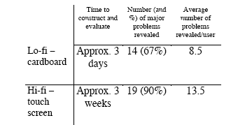
Comparing prototyping (Hall, 2001)

Slide 30
Learning Outcomes revisited
Check yourself to see if you can now:
  Explain participatory design and its importance to usability engineering
  Apply methods such as card sorting in designing any system or application
  Define the term “prototyping”
  Explain the importance of prototyping in designing for usability
  Identify the types of prototypes

Slide 31
Question and Answer Session
Q & A

Slide 32
Next Session
Topic and Structure of next session
Evaluation
Notes:
Proceed with giving the students the task for their second tutorial (finding badly design product) as they are to present their work in the next tutorial session

